Slide 1
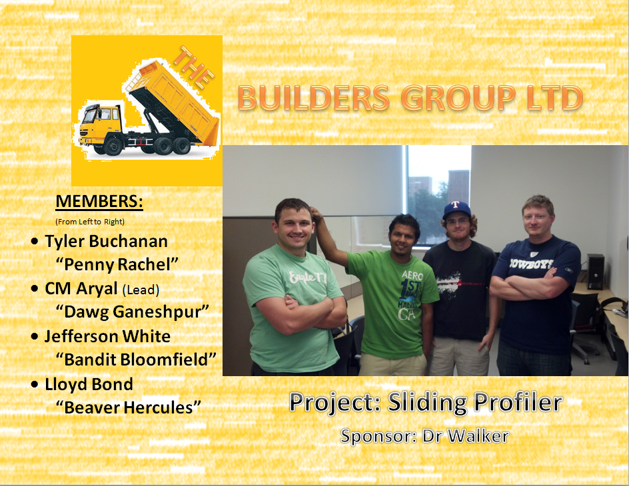
Notes:
Tyler
Notes: Made our display page in paint in like 5 minutes.

Slide 2
Responsibilities
Dawg Ganeshpur
Integration Lead
Scheduling
Project Planner
Beaver Hercules
Procurement
Quality
Note Taker
Penny Rachel
Documentation
Change Manager
Collaborator
Bandit Bloomfield
Presentation
Risk Management
Notes:
Tyler
Notes: These are the same as from our last presentation

Slide 3
Project Description
Sliding Profiler
A device for early detection of bumps in wet concrete so that location can be immediately smoothed before the concrete dries. The sliding profiler will be dragged across the wet pavement without disturbing it.
Notes:
Tyler
Notes: Just a very early vague description of the project

Slide 4
Meetings
Twice weekly
Early meetings with sponsor
Waiting on requirements
Outcomes:
Rough component diagram
Requirements
Hardware Possibilities
Risk Analysis
Notes:
Lloyd
Notes: What we’ve been doing at meetings, Outcomes explained in detail in following slides

Slide 5
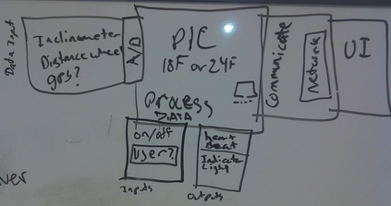
Component Diagram Draft
Notes:
Lloyd
Notes: How we imagine the end product

Slide 6
Miscellaneous Topics Discussed
Reviewed previous Sliding Profiler documents
Possibility of applying finish to Balsa Wood
Possible Frame type (Snowboard, Ski, Custom Frame)
GPS possibility
Notes:
Lloyd
Notes: Just a few points we’ve been covering during meetings

Slide 7
Rough Requirements
Balsawood base or Snowboard
16 bit A/D for inclinometer
Network capability
MicroChip PIC
UI - Show Raw and processed data
Etc.
Notes:
Jeff
Notes: Our guess at what the main requirements will look like, based on our meetings with Walker. Also has to ‘float’

Slide 8
Hardware Possibilities
AD9653: Quad, 16-Bit, 125 MSPS Serial LVDS 1.8 V Analog-to-Digital Converter - $250
MicroChip 16Bit A/D - < $3.00
Columbia Research Labs ±45º SI-701BHP Inclinometer - provided
Notes:
Jeff
Notes: Beginning research on some required parts. Also will need a MicroChip PIC controller, still doing research

Slide 9
Risk Analysis
Inadequate design
Short changed quality assurance
Premature or overly Frequent convergence
Communication with Sponsor
Poorly defined materials list
Notes:
CM
Notes: These are just the most important of the risks we may encounter

Slide 10
Work Planned
Finalize Requirements
SRD Document
Project Charter
Notes:
CM
Notes: What we’ll continue working on. Finalizing Requirements MUST come before SRD Document.

